Slide 1
Journey Map
Aum Rajadnye
Associate Data Engineer

Slide 2


Journey Map
Soft Skills
Aum Rajadnye
Associate Data Engineer

Slide 3
Key Learnings (14/08/23)
Professionalism and Etiquette
Adhering to a dress code
Behaviour in the office
Difference between a college setting and a corporate setting
Time Management
How to organize and manage time effectively
Reach out when need be. Be aware of capabilities and limitations

Slide 4
Key Learnings (16/08/23)
Video, Audio, Chat based Communication
Mannerisms and the way to approach a meeting changes depending on the medium of communication used
Be concise
Listening vs Hearing
How to work as a team and understood the value of teamwork

Slide 5
Key Learnings (17/08/23)
Email Etiquette
Communication Skills
Body Language
Listen, Understand and Empathise
Presentation Skills
Fluent speaking
How to address the audience
Mannerisms
Not using filler words

Slide 6

Journey Map
Foundational Skills
Aum Rajadnye
Associate Data Engineer

Slide 7
Business Analysis & Agile (18/08/23)
Professionalism and Etiquette
Adhering to a dress code
Behaviour in the office
Difference between a college setting and a corporate setting
Time Management
How to organize and manage time effectively
Reach out when need be. Be aware of capabilities and limitations

Slide 8
Scrum Call (21/08/23)
Understanding Agile DevOps on Azure in depth
Backlogs, Boards
Test plan, User stories, Epics, Issues etc.
Sprint (+ Iteration) creation
Mock daily stand-up meeting
Held mock Scrum call as a team exercise for mock application.
Visualize on Kanban Board

Slide 9
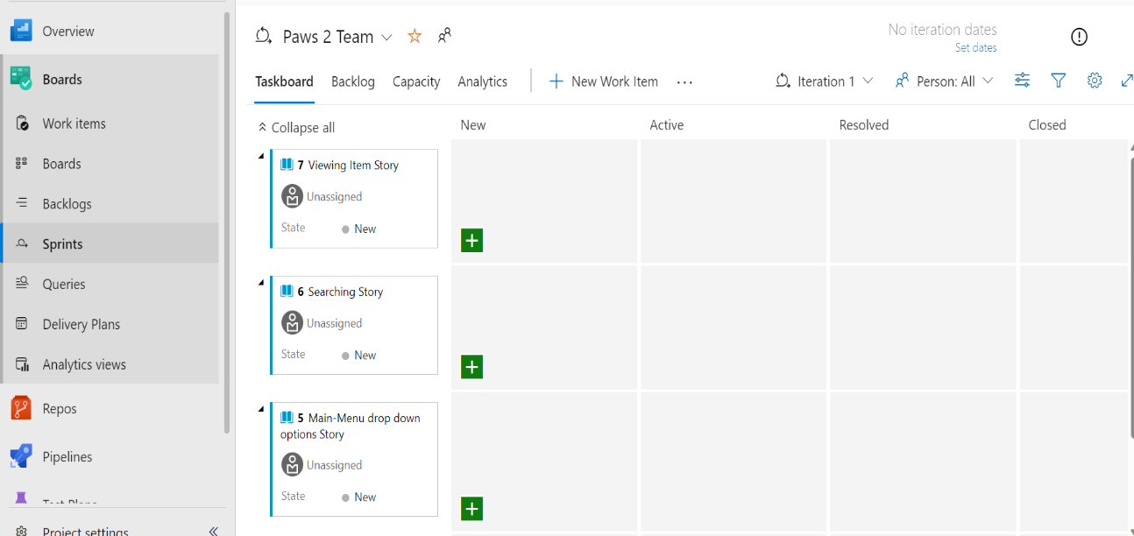
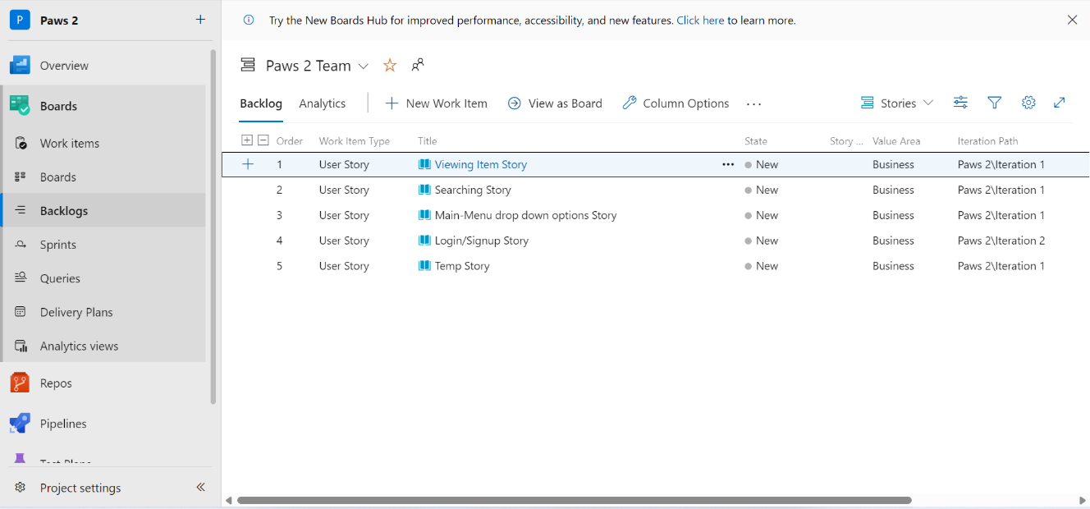
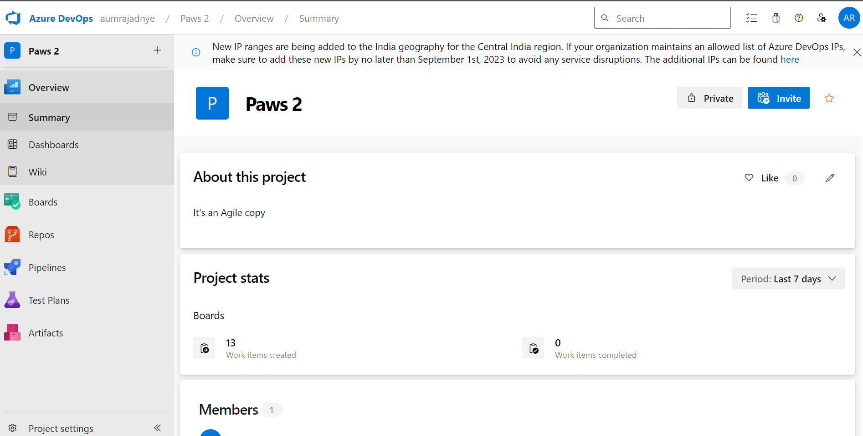
Sprints
Backlogs
Organization Structure

Slide 10
DBMS (22/08/23)
SQL
DML, DDL, DQL, DCL, TCL
SELECT, WHERE, ORDER BY, GROUP BY, HAVING
Hands-on session of different SQL Queries
Normalization
Understood 1NF, 2NF, 3NF, BC-NF, 4NF, 5NF in Relational Database Management System
Joins – Inner (Natural), Outer, Left join

Slide 11
Testing (23/08/23)
Software Development Life Cycle (SDLC)
Types of SDLC – Waterfall model, Agile model
Software failure and scope to trackback with respect to different development models
Software Testing Life Cycle (STLC)
Phases of STLC – Test Strategy, Plan, Design, Environment, Execution, Reporting, Closure
SDLC vs STLC

Slide 12
DevOps (24/08/23)
Continuous Integration and Continuous Deployment
Repository based DevOps process to make continuous changes for automation and testing
Discussed CI vs CD
GitHub Actions
Components of GitHub Actions – Workflows, Events, Jobs, Actions, Runners
Sample Action file in YAML file format

Slide 13
Cloud Computing (25/08/23)
Cloud Computing
What is cloud computing, it’s advantages and limitations
Concepts such as SAAS, PAAS, IAAS with examples
Using Azure’s suite of Cloud Computing tools
Virtual Machines
Creating VMs on Azure and accessing them remotely
Behaviour in the office
Reach out when need be. Be aware of capabilities and limitations

